Slide 1

Extract, Transform, and Load
(ETL)
Presented by: Abdulrahman Mohammed
Presented to: Big Data Team
Team Lead: Mohamed Emad El-Dien
Supervised By : Zeyad Taher

Slide 2
Extract, Transform, and Load (ETL)
An Overview of ETL Processes and Evolution

Slide 3
What is ETL?
It is the process of integrating data from multiple sources into a central data warehouse.
Cleans and organizes raw data for storage, analytics, and machine learning (ML).
Enables business intelligence by generating reports, dashboards, and predicting outcomes.

Slide 4
Why is ETL important?
Data Sources in Organizations:
Organizations handle structured and unstructured data from various sources.
Common data sources include:
CRM systems
Vendor systems
IoT devices
Social media
HR systems.

Slide 5
Role of ETL in Data Processing
ETL prepares raw datasets for analytics.
Enables businesses to gain meaningful insights, such as:
Predicting demand
Managing inventory
Analyzing consumer behavior

Slide 6
How does ETL benefit business intelligence?
Historical Context: Combines legacy and new data for long-term analysis.
Consolidated Data View: Integrates multiple datasets for improved efficiency.
Accurate Data Analysis: Ensures data quality and compliance.
Task Automation: Reduces manual processing efforts.

Slide 7
How has ETL evolved?
Traditional ETL: Transformed transactional data into relational formats for analysis.
Modern ETL: Handles diverse data sources, cloud-based data sinks, and advanced transformations.
Data Warehouses: Centralized repositories for structured data.
Data Lakes: Store structured and unstructured data for flexible analytics

Slide 8
How does ETL work?
ETL follows three key steps:
Extract: Pull data from various sources into a staging area.
Transform: Clean, standardize, and apply business rules.
Load: Move transformed data to the target system.

Slide 9
What is data extraction?
Update Notification: Source notifies when data changes.
Incremental Extraction: Periodically extracts modified data.
Full Extraction: Reloads all data when change tracking is unavailable.

Slide 10
What is data transformation?
Basic: Cleansing, deduplication, format standardization.
Advanced: Business rules, joining, splitting, summarization, encryption.

Slide 11
What is data loading?
Full Load: Transfers entire dataset initially.
Incremental Load: Updates only changed data.
Streaming Load: Continuous small data updates.
Batch Load: Periodic updates for large data volumes.

Slide 12
What is ELT?
Extract, Load, and Transform (ELT) reverses the ETL process by loading raw data first and transforming it within the data warehouse. ELT is more suited for cloud-based and big data applications.

Slide 13
ETL vs ELT
ETL: Defines structure and relationships before loading; ideal for legacy systems.
ELT: Loads raw data first and transforms it later; preferred for modern cloud-based analytics.

Slide 14
Common ETL Tools
• Enterprise: Informatica PowerCenter, Microsoft SSIS, Talend.
• Cloud: AWS Glue, Google Dataflow, Azure Data Factory.
• Open-Source: Apache Nifi, Airbyte, Apache Spark.

Slide 15
ETL Challenges
• Handling large data volumes
• Ensuring data quality
• Managing real-time processing
• Adapting to schema changes
• Monitoring job failures

Slide 16
Real-World ETL Use Cases
• E-Commerce: Sales and order processing.
• Healthcare: Integrating patient records.
• Finance: Fraud detection and compliance.
• IoT: Streaming sensor data.

Slide 17
Best Practices for ETL
• Optimize extraction with indexing and partitioning.
• Improve transformation with parallel processing.
• Efficient loading via bulk inserts.
• Automate with Airflow.
• Ensure scalability using cloud-based ETL.

Slide 18
Conclusion
• ETL is essential for reliable data pipelines.
• Choosing the right tools and handling challenges ensures efficiency.

Slide 19
Introduction to Data Warehouses
- A Data Warehouse (DW) is a central repository designed for analytics and reporting.
- Integrates data from multiple sources to provide a single version of truth.
- Key characteristics:
- Subject-oriented
- Integrated
- Time-variant
- Non-volatile

Slide 20
Why Use a Data Warehouse?
- Helps organizations make data-driven decisions.
- Stores historical data for trend analysis and forecasting.
- Improves query performance for reporting.
- Provides data consistency across departments.

Slide 21
Data Warehouse Architecture
- Data Sources: CRM, ERP, Social Media, IoT devices, etc.
- ETL Process: Extract, Transform, Load (ETL) moves data to the warehouse.
- Data Warehouse: Centralized storage optimized for querying.
- BI Tools: Dashboards, reports, and analytics platforms consume the data.

Slide 22
Fact Tables in Data Warehousing
- Fact tables store measurable business events (e.g., sales, orders, transactions).
- Contains metrics (facts) and foreign keys referencing dimension tables.
- Example: FCT_SALES with facts like total_sales, quantity_sold, revenue.

Slide 23
Types of Fact Tables
1. Transactional Fact Tables: Stores detailed events (e.g., sales orders per transaction).
2. Periodic Snapshot Fact Tables: Captures data at specific time intervals (e.g., daily sales).
3. Accumulating Snapshot Fact Tables: Tracks a process over time (e.g., order fulfillment stages).

Slide 24
Dimension Tables
- Dimension tables store descriptive attributes (e.g., customer, product, location).
- Each record has a primary key that links to the fact table.
- Example: DIM_PRODUCT with attributes Product_ID, Name, Category, Brand.

Slide 25
Slowly Changing Dimensions (SCDs)
- SCDs track changes in dimension data over time.
- Types of SCDs:
1. SCD Type 1: Overwrites old data (e.g., updating an address without history).
2. SCD Type 2: Keeps historical versions (e.g., adding a new row for address change).
3. SCD Type 3: Keeps limited history using an additional column (e.g., previous address).

Slide 26
Choosing the Right SCD Type
- Type 1: When historical changes do not matter.
- Type 2: When maintaining full history is essential.
- Type 3: When a limited historical reference is needed.

Slide 27
Project Overview
Project Name: E-Commerce Data Warehousing Solution
Purpose: Design and implement a scalable data warehouse for analytics and reporting.
ETL Tool Used: Informatica.
Schema Design: Star Schema (Fact and Dimension Tables).

Slide 28
Business Needs
When is the peak season of our e-commerce?
What time users are most likely make an order or using the ecommerce app?
What is the preferred way to pay in the ecommerce?
How many installment is usually done when paying in the ecommerce?
What is the frequency of purchase on each state?

Slide 29
Which logistic route that has heavy traffic in our e-commerce?
How many late deliveries have been made in our e-commerce? Are late orders affecting customer satisfaction?
How long are the delays for the delivery/shipping process in each state?
How long are the difference between estimated delivery time and actual delivery time in each state?

Slide 30


Slide 31
Solution Approach
1- Data Warehouse Model:
Design a star schema with fact and dimension tables to store and analyze structured data.
Key Tables:
Fact Tables: Order
Dimension Tables: User, Seller, Product, Feedback, Payment, Order Item, Time, Date.
2-ETL pipelines for staging layer
3-ETL pipelines for the Data warehouse layer

Slide 32
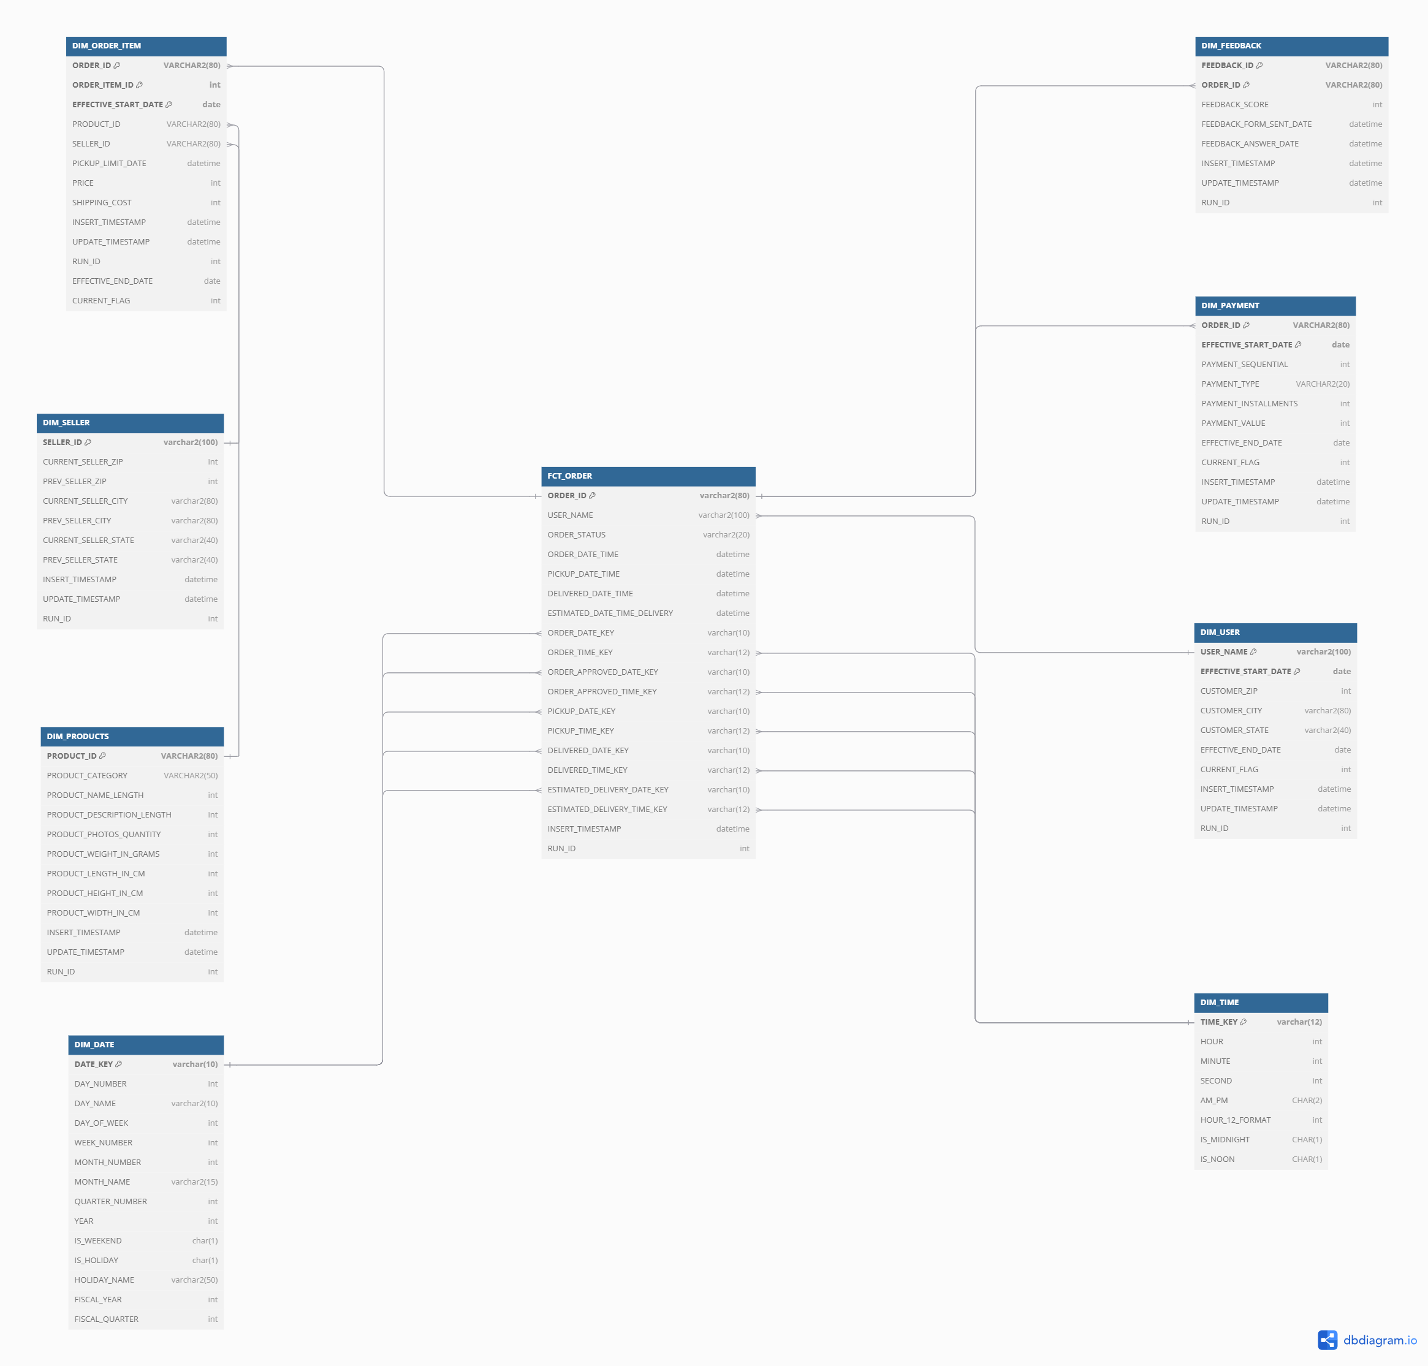

Slide 33
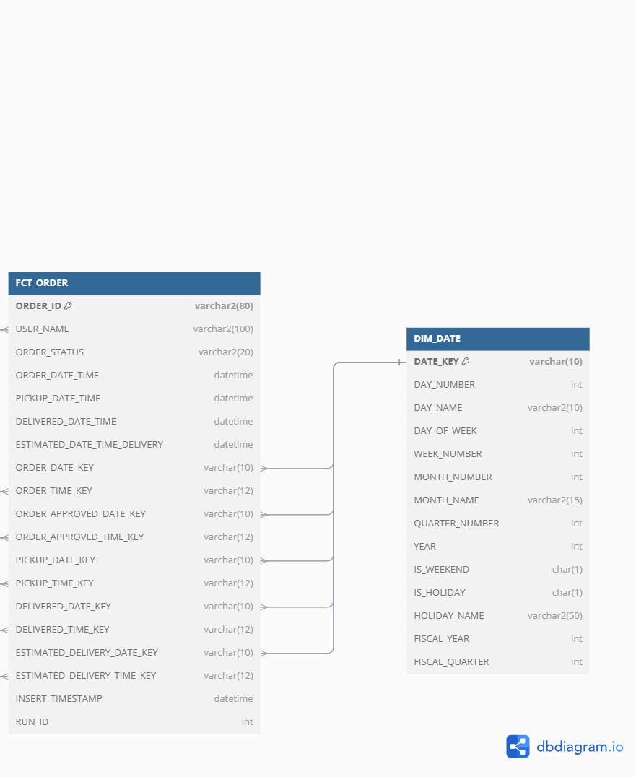
Why this model supports business needs
1. When is the peak season of our e-commerce?
Data Sources:
FCT_ORDER
DIM_DATE.QUARTER
.

Slide 34
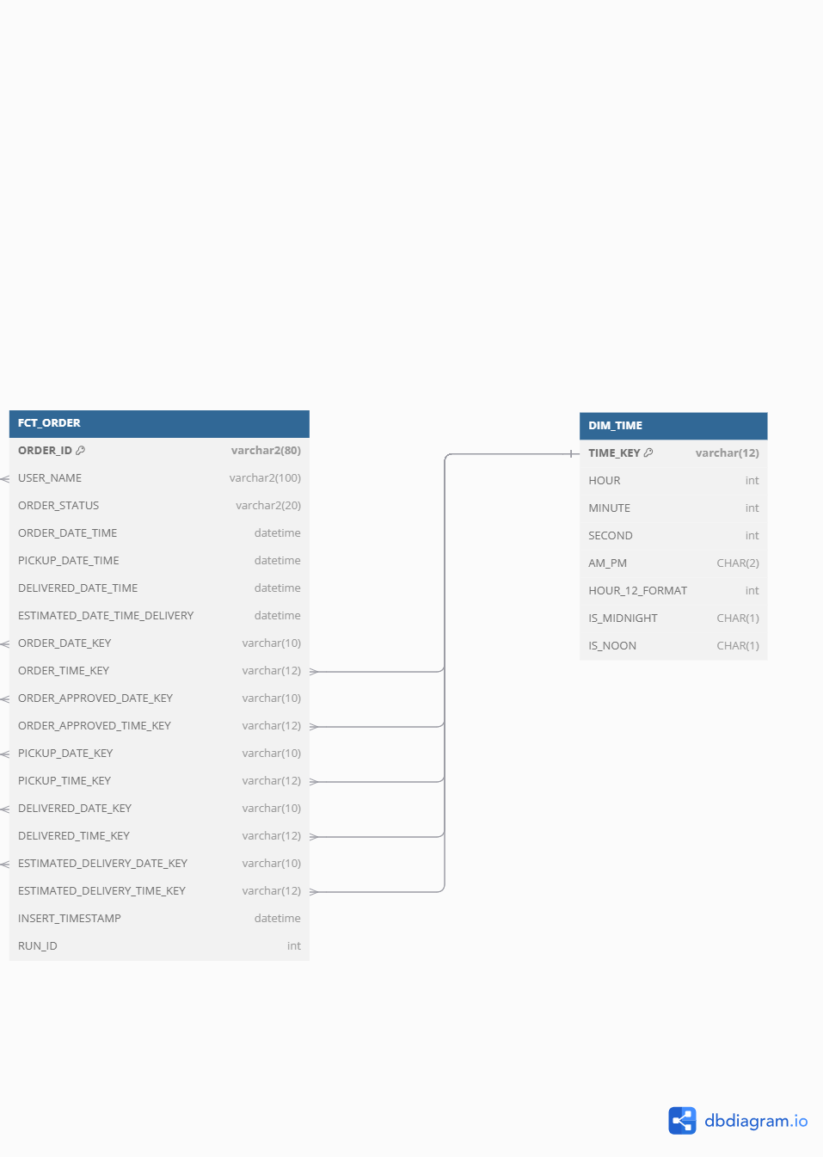
2. What time users are most likely to make an order or use the e-commerce app? Data Sources: FCT_ORDER DIM_TIME

Slide 35
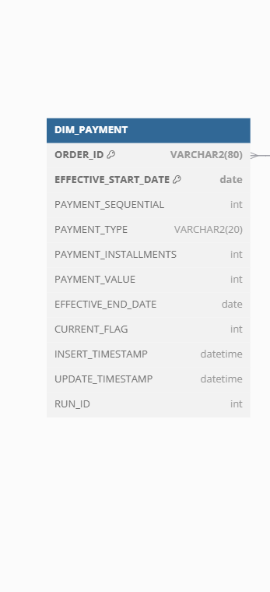
3. What is the preferred way to pay in e-commerce?
Data Sources:
DIM_PAYMENT
4. How many installments are usually done when paying in e-commerce?
Data Sources:
DIM_PAYMENT

Slide 36
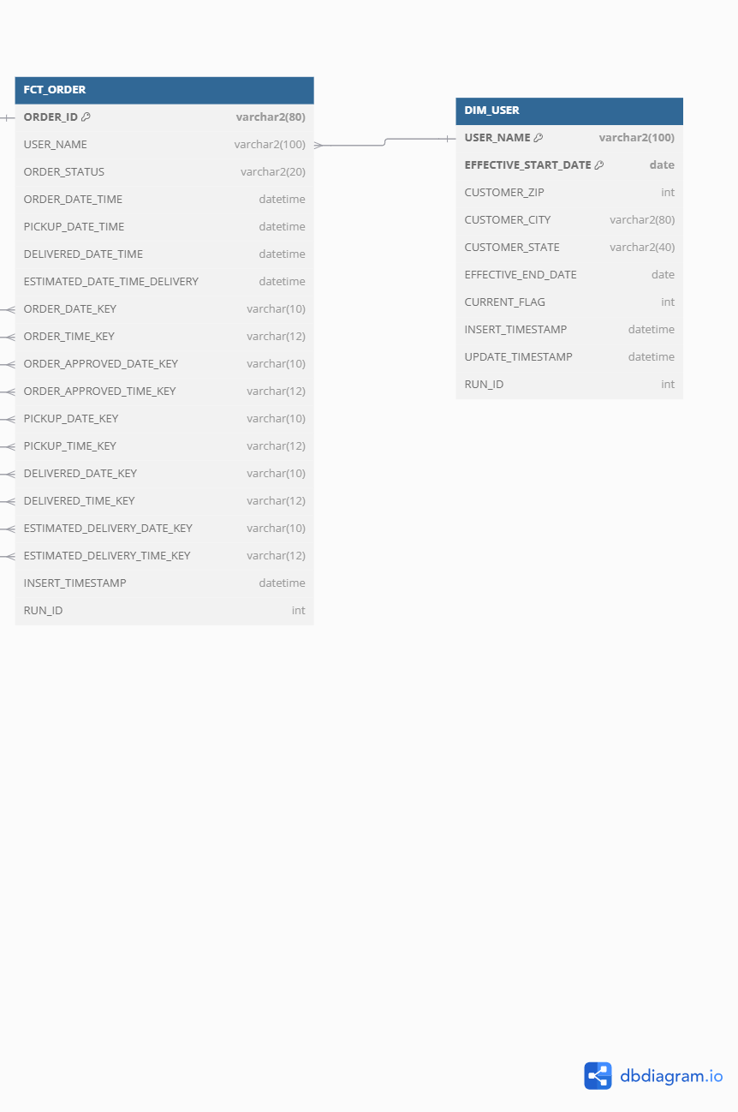
5. What is the frequency of purchase in each state?
Data Sources:
DIM_USER.
FCT_ORDER (linked to users through USER_NAME)

Slide 37
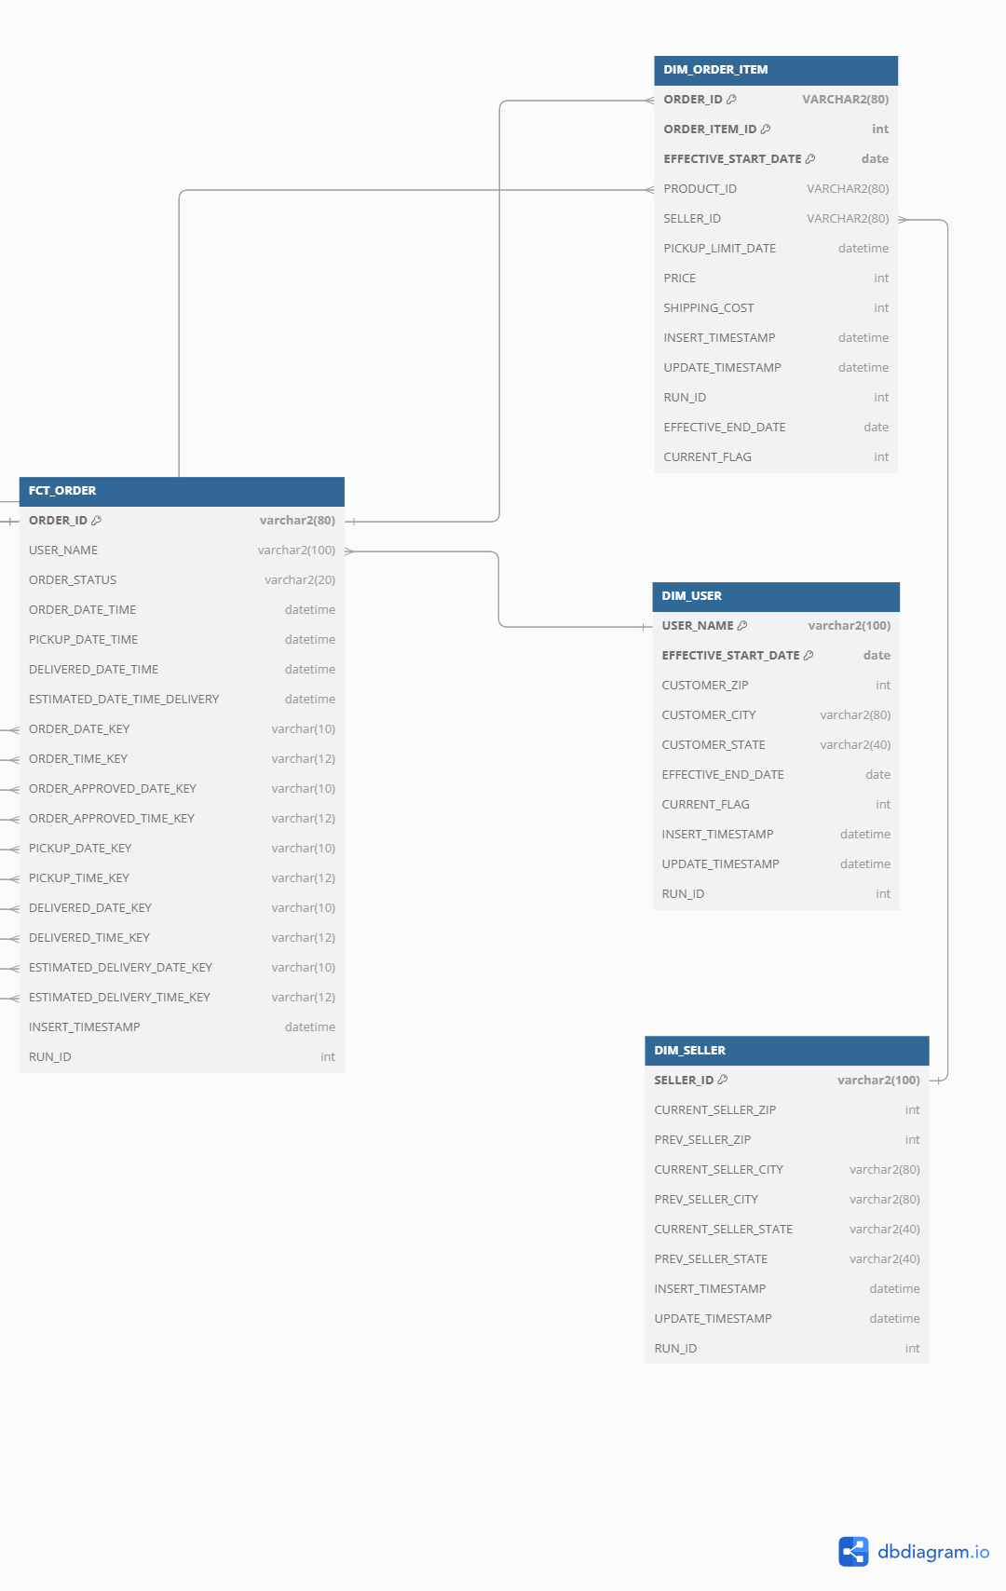
6. Which logistic route has heavy traffic in our e-commerce? Data Sources: FCT_ORDER DIM_USER DIM_SELLER DIM_ORDER_ITEM.

Slide 38
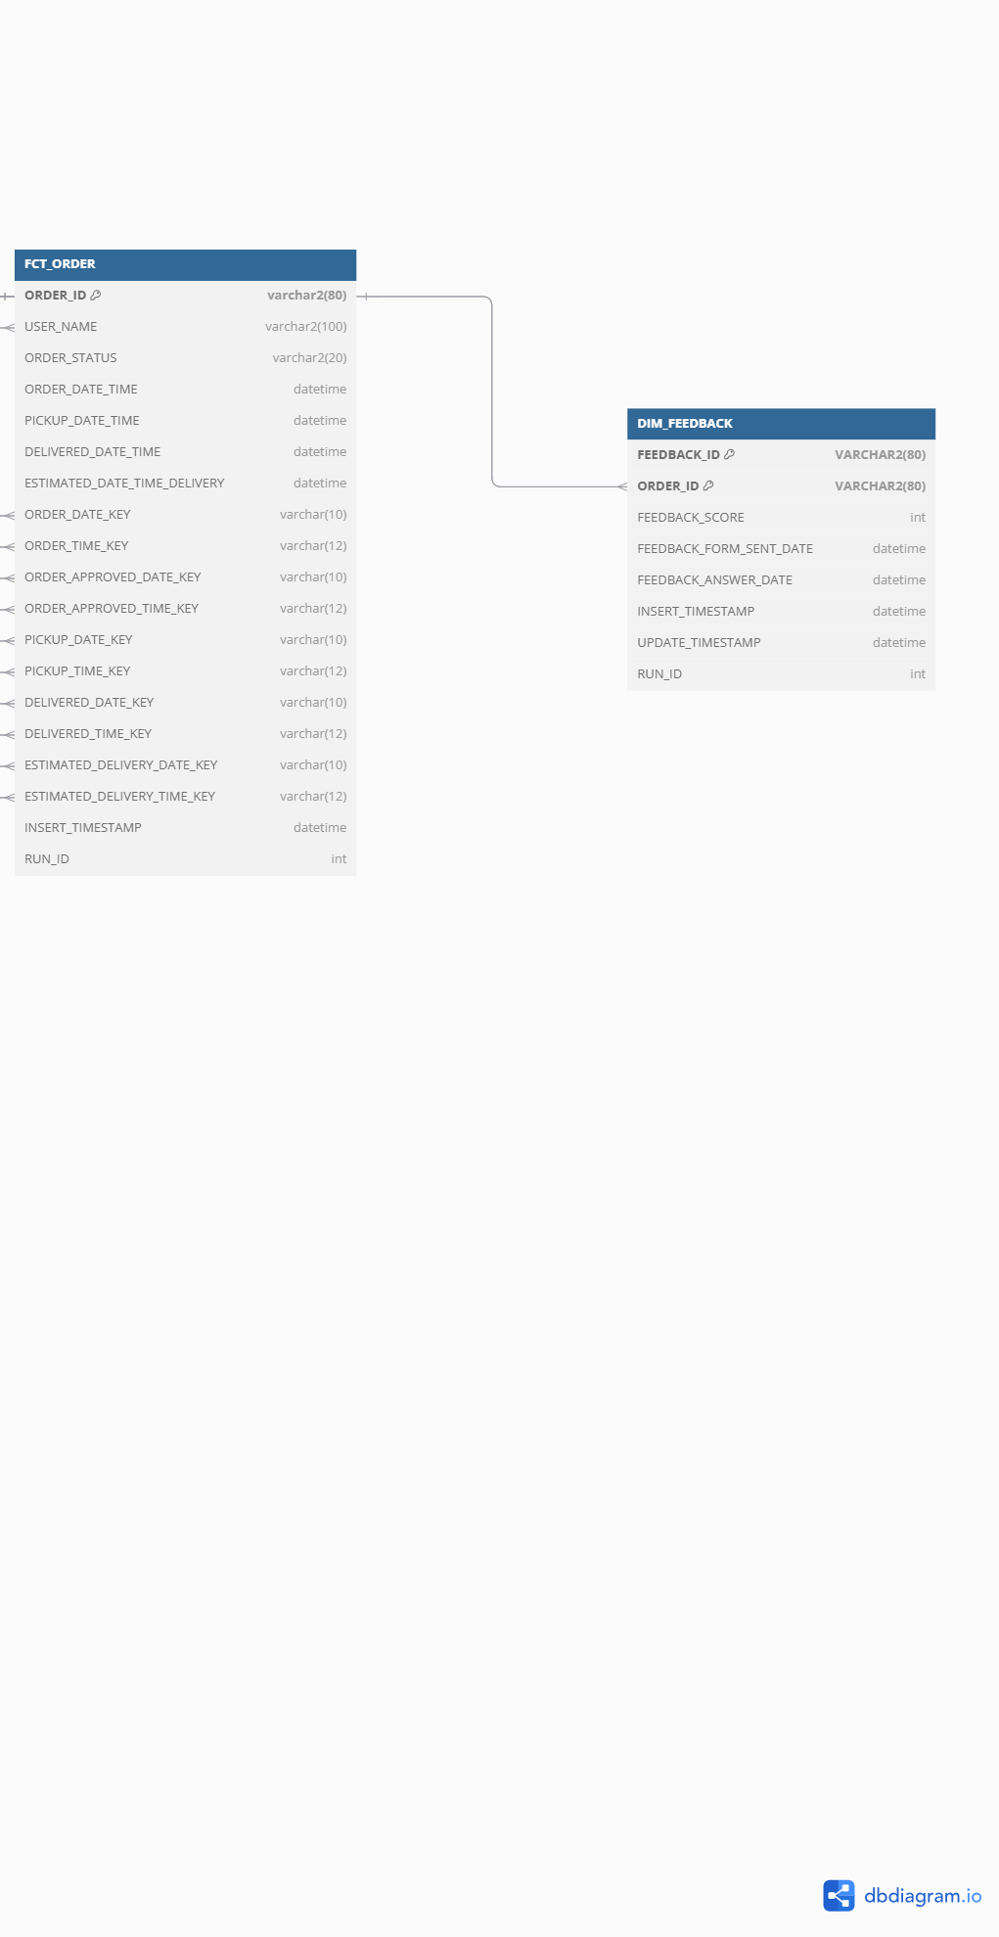
7. How many late delivered orders are in our e-commerce? Are late orders affecting customer satisfaction?
Data Sources:
FCT_ORDER.
DIM_FEEDBACK.

Slide 39
ETL pipelines for staging layer
Staging Layer Workflow in This Project:
In this project, the staging layer was designed to load data from flat files into temporary staging tables in Oracle before transforming and loading it into the Data Warehouse. The ETL process was implemented using Informatica, ensuring smooth data movement from sources to targets.

Slide 40
Steps in Staging Layer Implementation
Data Extraction
Data was extracted from seven flat files containing raw e-commerce transactions.
Informatica mappings were created to read the flat file data.
Data Loading to Staging Tables
Each flat file was mapped to a corresponding staging table in Oracle.
No transformations were applied at this stage, ensuring a raw replica of the source.
Data Transformation
Basic formatting (e.g., date and number conversions) was applied.

Slide 41
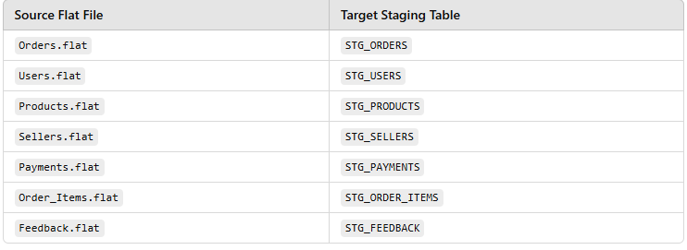
6. Staging Layer Mapping Example in Informatica
For each file, an Informatica mapping was created, reading from the source flat file and loading into an Oracle staging table.

Slide 42
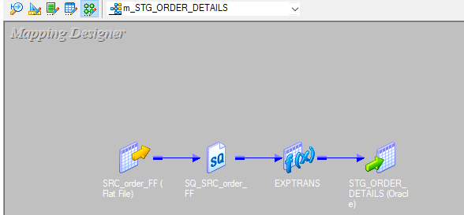
1. Mapping Overview (ORDER)
Mapping Name: [m_STG_ORDER_DETAILS]
Source File: [SRC_order_FF)]
Target Table: [STG_ORDER_DETAILS]
Description: [DATA IS LOADED FROM SOURCE FILE TO STAGING TABLE]

Slide 43
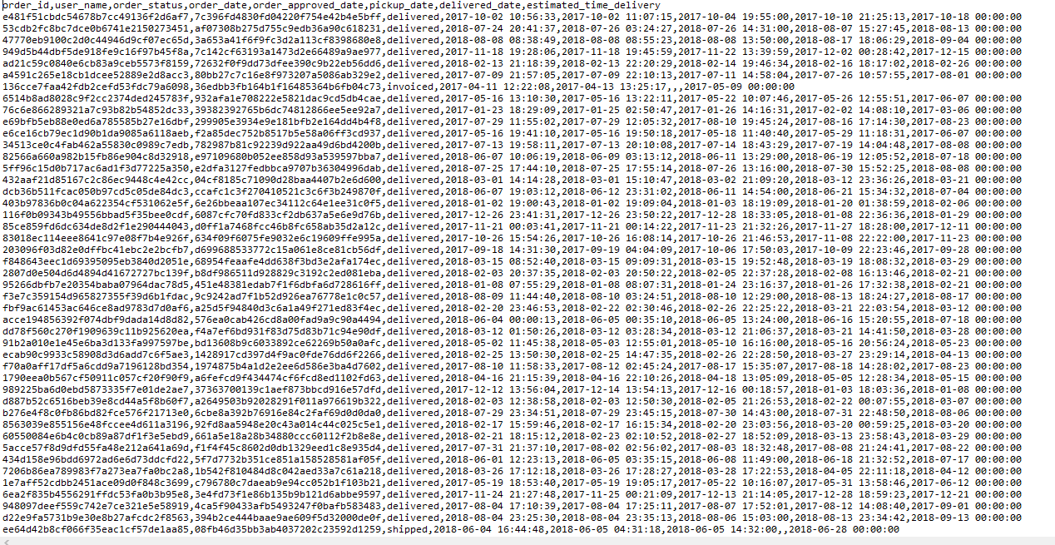
2. Source File Details
File Name: [SRC_order_FF]
File Type: [CSV]
Delimiter: [Comma]

Slide 44
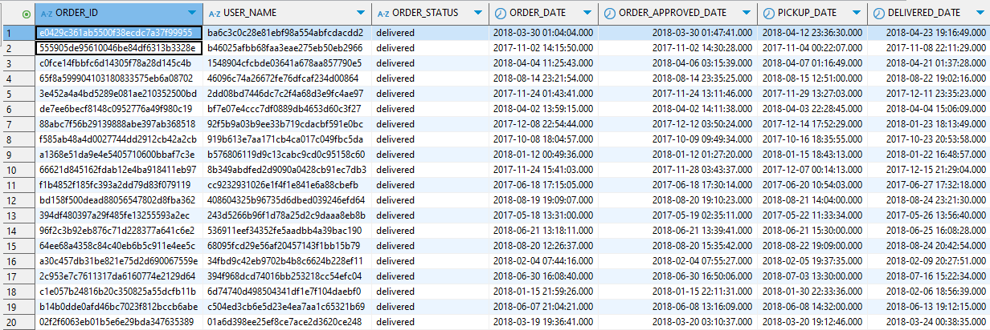
3. Target (Staging Table) Details
Table Name: [STG_ORDER_DETAILS]
DATABASE:[ORACLE]

Slide 45
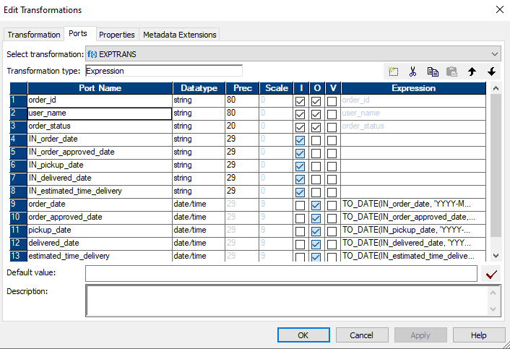
Transformations Applied:

Slide 46
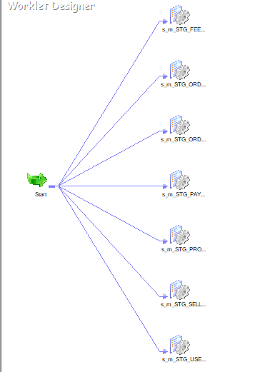

Slide 47
ETL pipelines for the Data warehouse layer
ETL Process for My Data Warehouse
Extraction: Data is pulled from staging tables.
Transformation: Business rules are applied
Loading: Transformed data is inserted into warehouse tables

Slide 48
2. Data Warehouse Schema Design
This project follows a star schema structure:
One Fact Table (FCT_ORDER) → Captures order lifecycle events.
Six Dimension Tables:
DIM_USER → Stores customer details.
DIM_SELLER → Stores seller information.
DIM_PRODUCT → Stores product details.
DIM_PAYMENT → Stores payment methods and installment details.
DIM_FEEDBACK → Stores customer feedback on orders.
DIM_ORDER_ITEM → Captures details of items within each order.
Supporting Time & Date Dimensions:
DIM_DATE → Enables date-based analysis.
DIM_TIME → Enables time-based events.

Slide 49
Data Warehouse Mapping Examples
Example 1: DIM_FEEDBACK – Slowly Changing Dimension Type 1
Example 2: DIM_PAYMENT – Slowly Changing Dimension Type 2
Example 3: DIM_SELLER – Slowly Changing Dimension Type 3

Slide 50
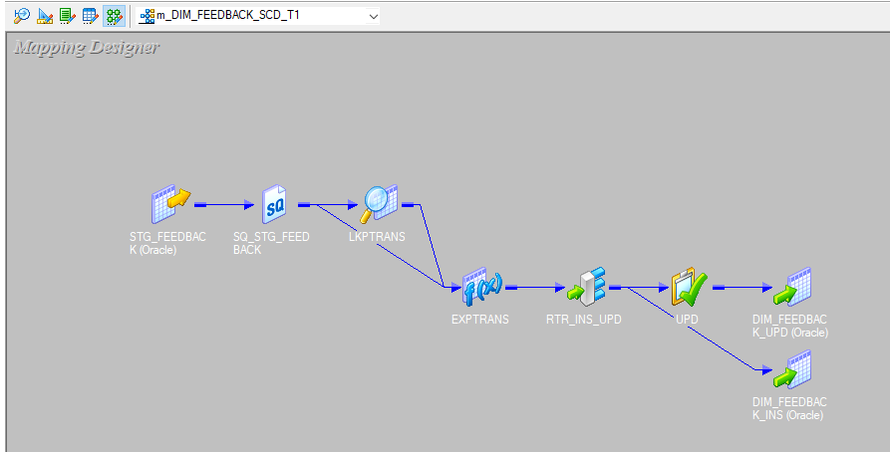
1. Mapping Overview(DIM_FEEDBACK)
Mapping Name: [m_DIM_FEEDBACK_SCD_T1]
Source Table: [STG_FEEDBACK]
Target Table: [DIM_FEEDBACK]

Slide 51
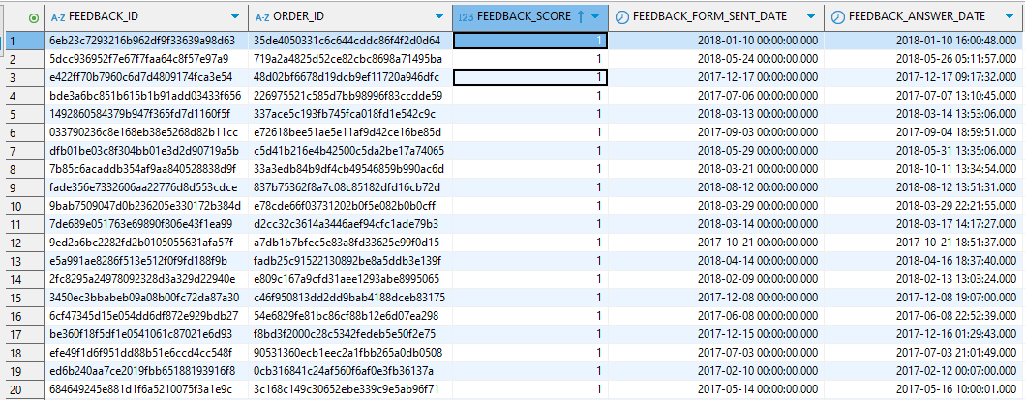
2. Source (Staging Table) Details
Table Name: [STG_FEEDBACK]

Slide 52
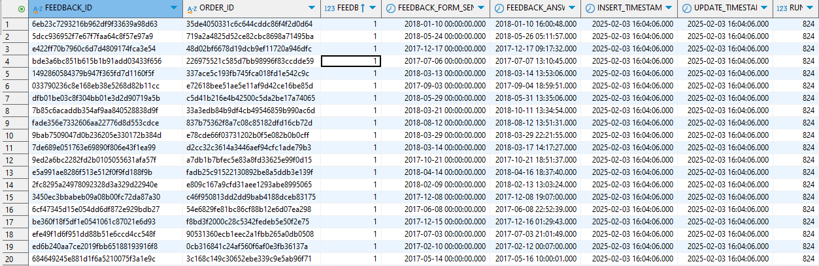
3. Target (Data Warehouse Table) Details
Table Name: [DIM_FEEDBACK]
Table Type: [Dimension]

Slide 53
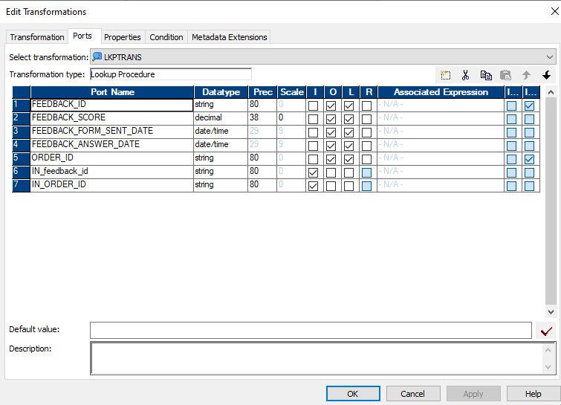
Lookup Transformation

Slide 54
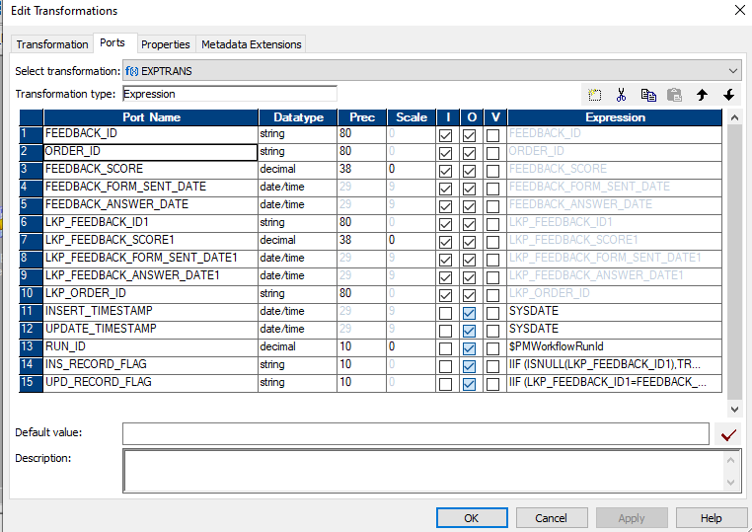
Transformations Applied
Expression Transformation

Slide 55
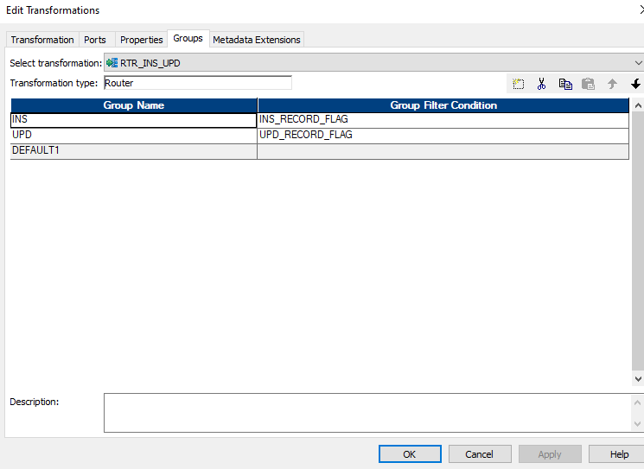
ROUTER Transformation

Slide 56
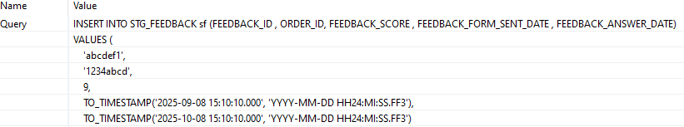
SCD Type 1 Verification Process(DIM_FEEDBACK)
Step 1: Insert a New Record into STG_FEEDBACK

Slide 57
Step 2: Run the Informatica Workflow
Step 3: Verify Data in DIM_FEEDBACK Table

Slide 58

Step 4: Update the Record in STG_FEEDBACK

Slide 59
Step 5: Re-run the Informatica Workflow
Step 6: Verify the Update in DIM_FEEDBACK

Slide 60
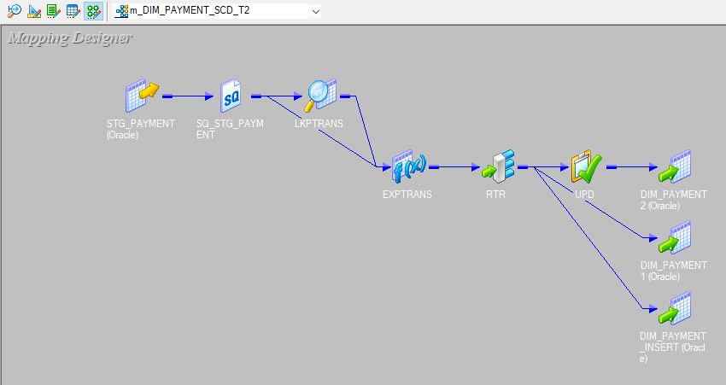
1. Mapping Overview(DIM_PAYMENT)
Mapping Name: [m_DIM_PAYMENT_SCD_T2]
Source Table: [STG_PAYMENT]
Target Table: [DIM_PAYMENT]

Slide 61
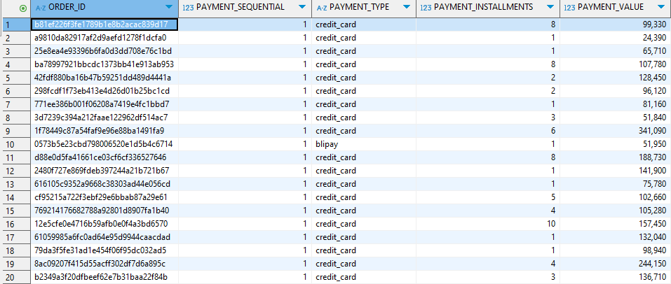
2. Source (Staging Table) Details
Table Name: [STG_PAYMENT]

Slide 62
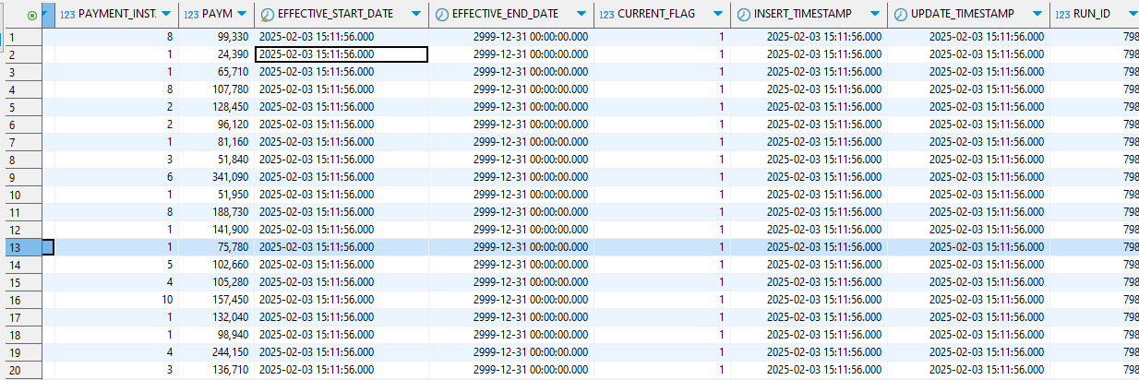
3. Target (Data Warehouse Table) Details
Table Name: [DIM_PAYMENT]
Table Type: [Dimension Table]

Slide 63
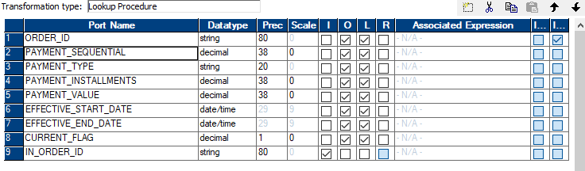
Transformations Applied
Lookup Transformation;

Slide 64
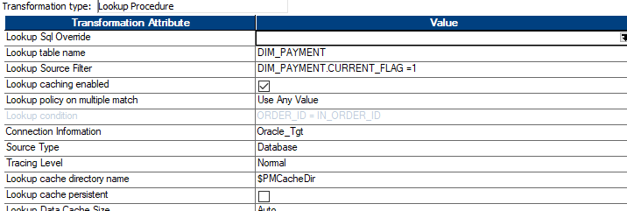

Slide 65
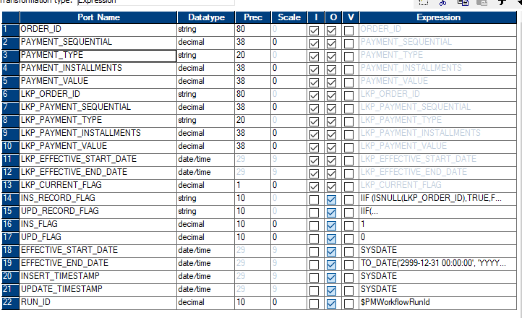
Expression Transformation:

Slide 66
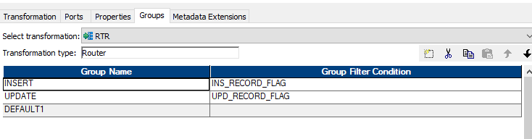
ROUTER Transformation

Slide 67
SCD Type 2 Verification Process(DIM_PAYMENT
Step 1: Insert a New Record into STG_PAYMENT

Slide 68
Step 2: Run the Informatica Workflow
Step 3: Verify Data in DIM_PAYMENT Table

Slide 69

Step 4: Update the Record in STG_PAYMENT

Slide 70
Step 5: Re-run the Informatica Workflow
Step 6: Verify the Update in DIM_PAYMENT

Slide 71
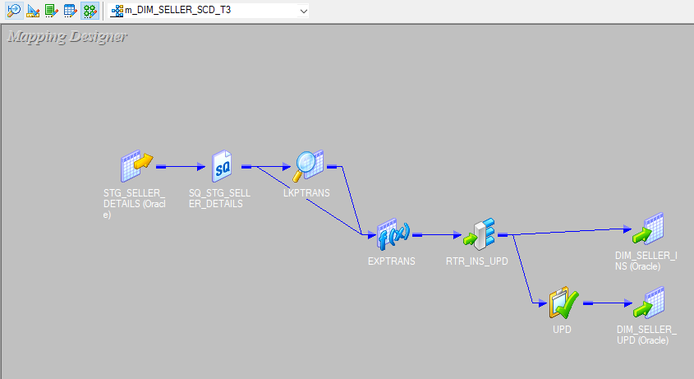
1. Mapping Overview(DIM_SELLER)
Mapping Name: [m_DIM_SELLER_SCD_T3]
Source Table: [STG_SELLER_DETAILS]
Target Table: [DIM_SELLER]

Slide 72
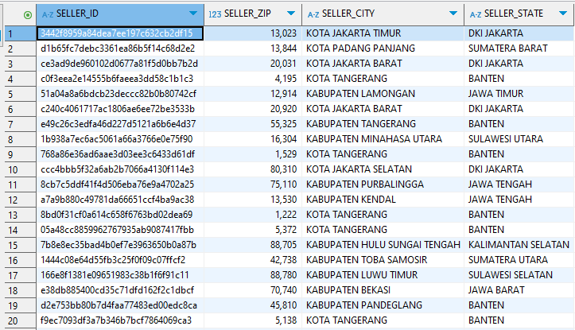
2. Source (Staging Table) Details
Table Name: [STG_SELLER_DETAILS]

Slide 73
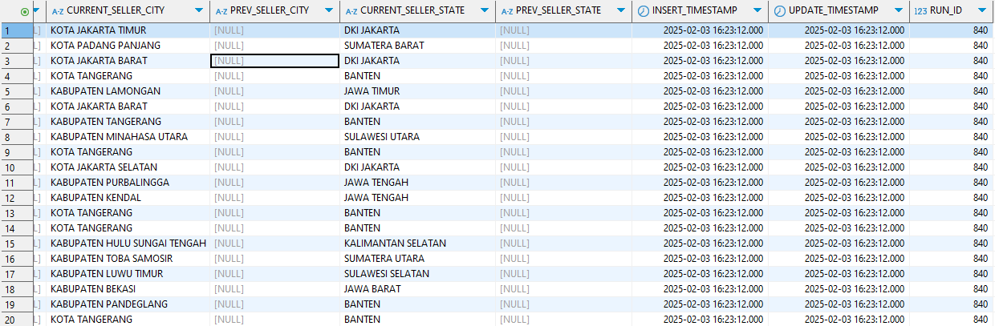
3. Target (Data Warehouse Table) Details
Table Name: [DIM_SELLER]
Table Type: [Dimension]

Slide 74
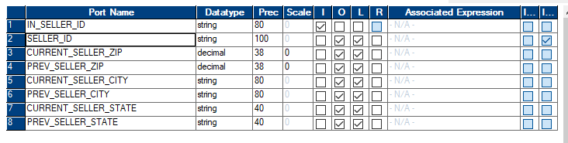
Transformations Applied
Lookup Transformation

Slide 75
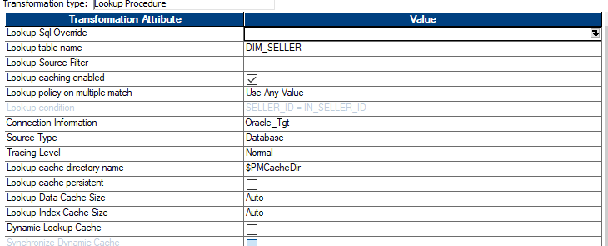

Slide 76
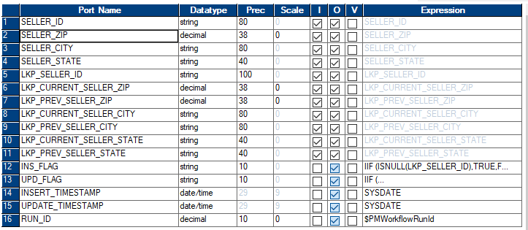
Expression Transformation

Slide 77
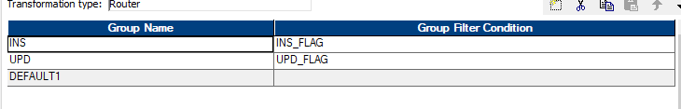
ROUTER Transformation:

Slide 78

SCD Type 3 Verification Process(DIM_SELLER)
Step 1: Insert a New Record into STG_SELLER_DETAILS

Slide 79
Step 2: Run the Informatica Workflow
Step 3: Verify Data in DIM_SELLER Table

Slide 80
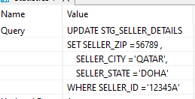
Step 4: Update the Record in STG_SELLER_DETAILS

Slide 81
Step 5: Re-run the Informatica Workflow
Step 6: Verify the Update in DIM_SELLER

Slide 82
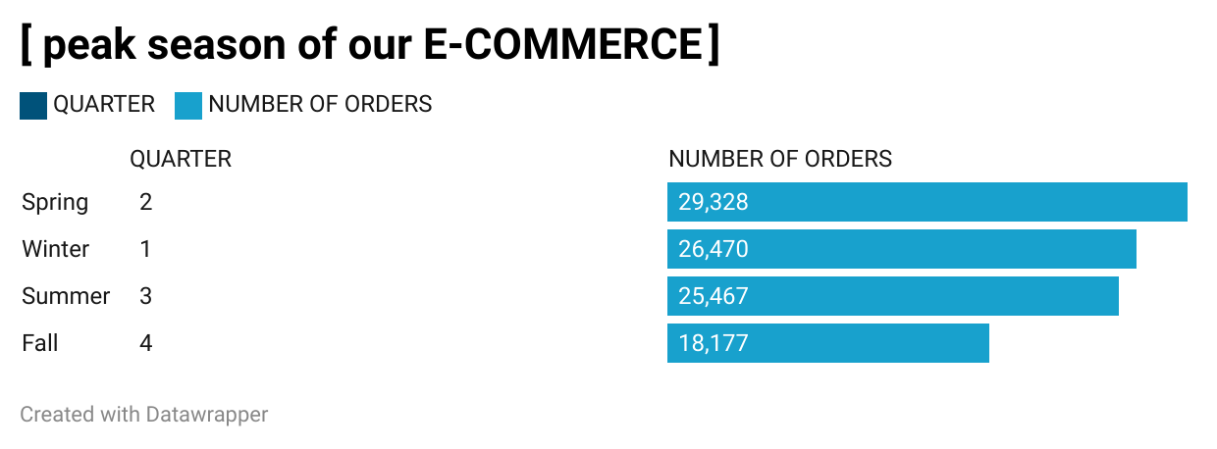

Slide 83
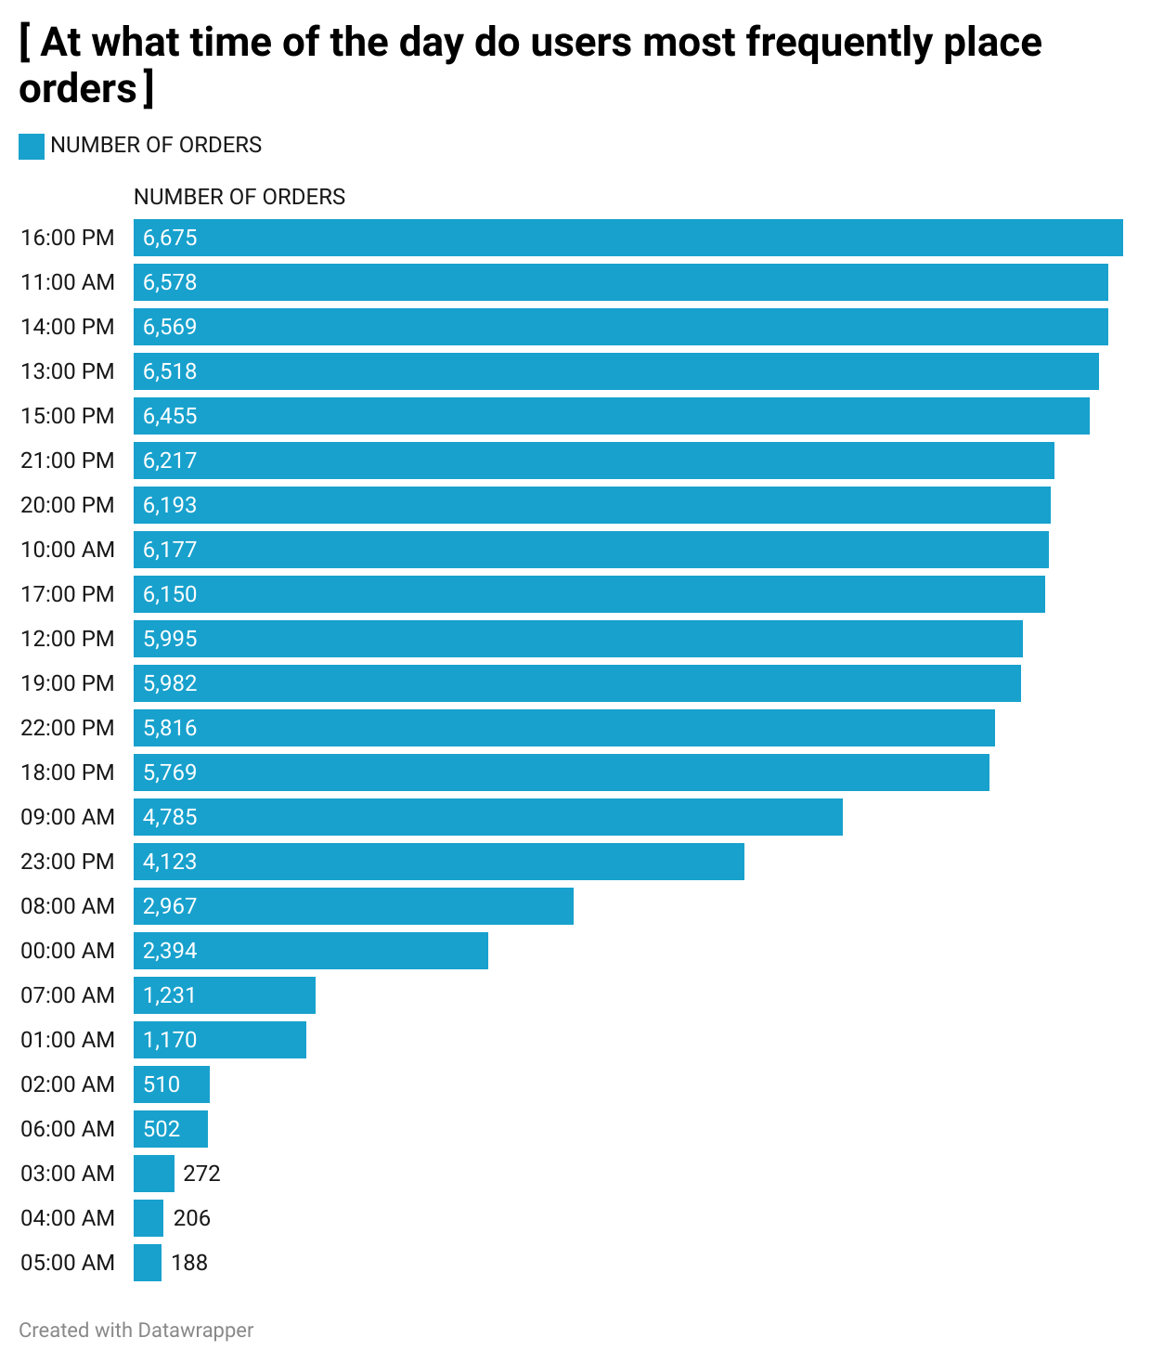

Slide 84
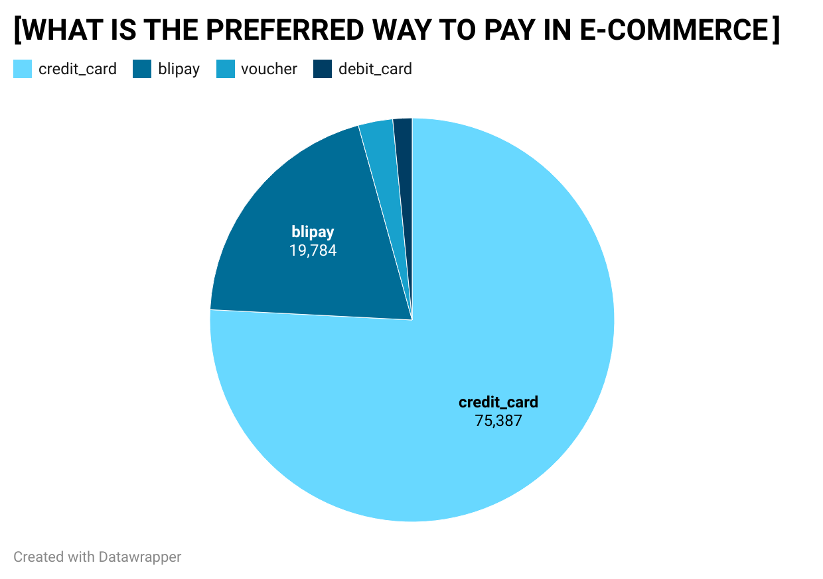

Slide 85
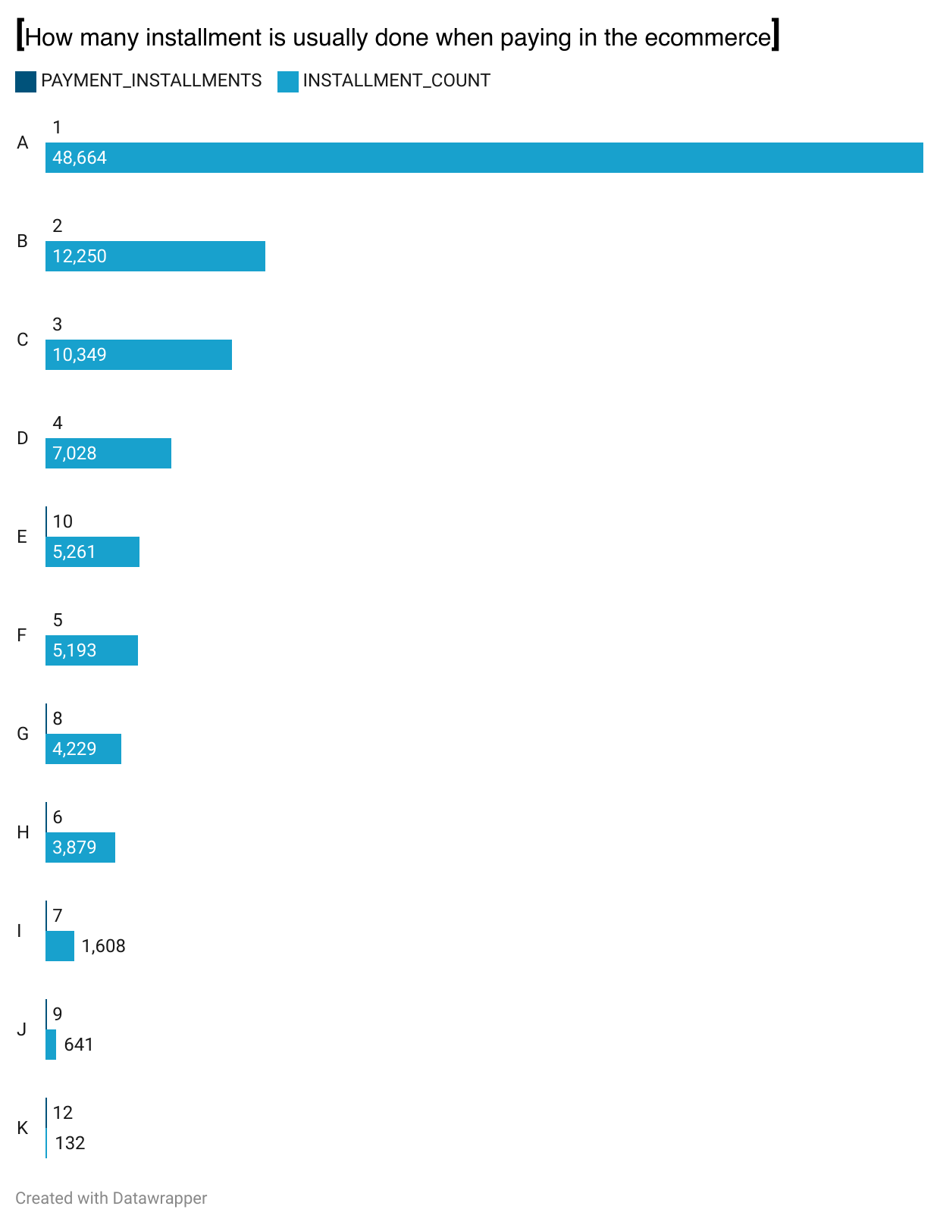

Slide 86
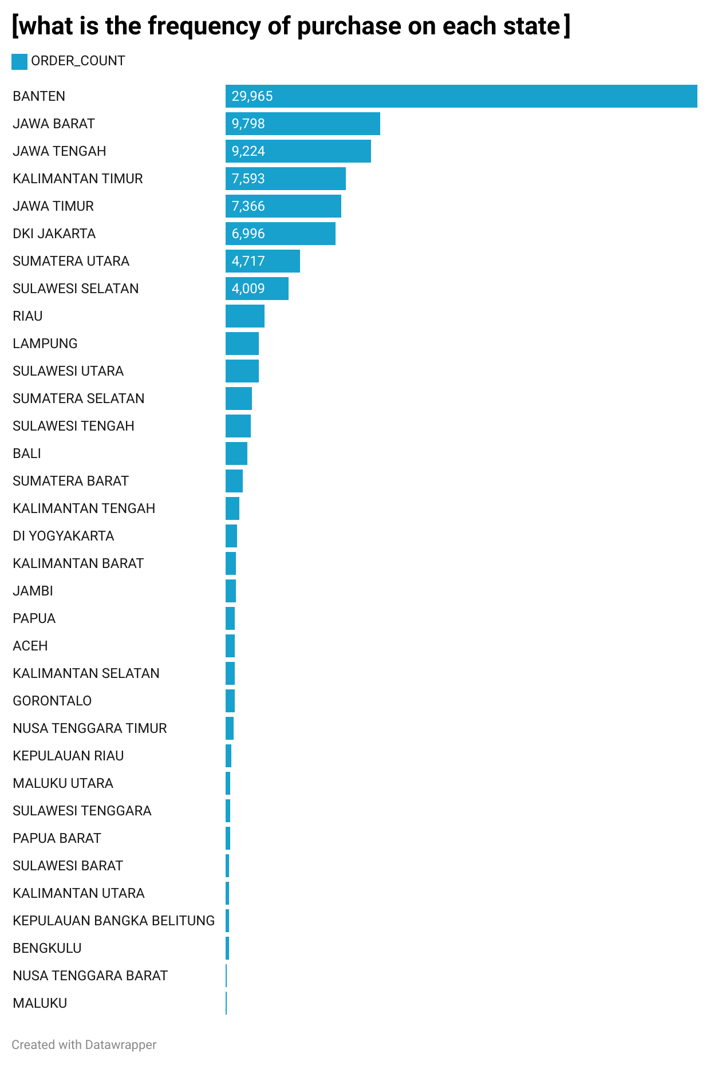

Slide 87
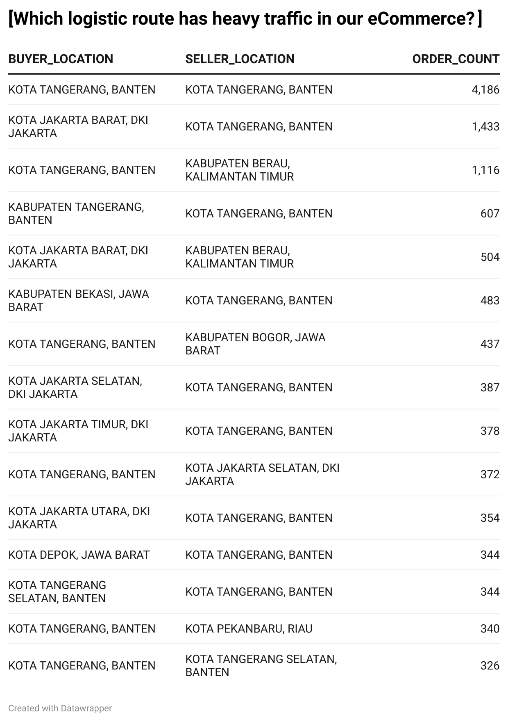

Slide 88
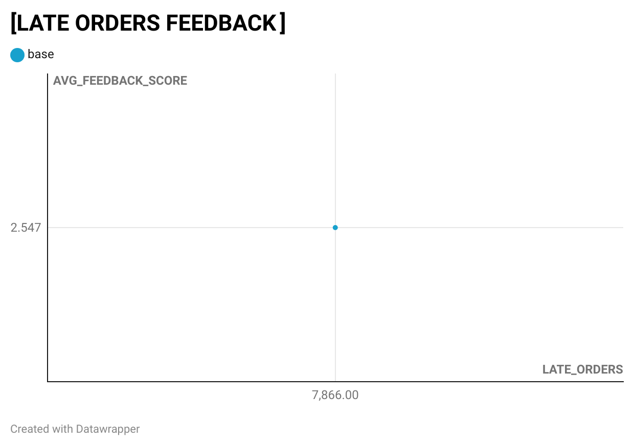

Slide 89
